Slide 1
eBay AR
Peng Ivan, Wang, Jing, Zou Daohua, Yang Baoling
2016.6.24

Slide 2
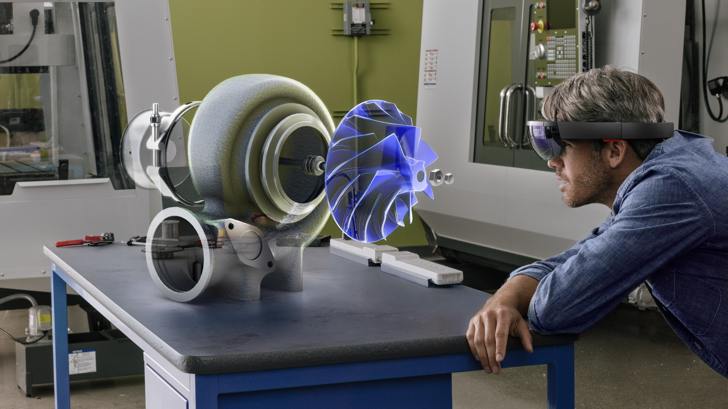
AR
- Augmented Reality

Slide 3
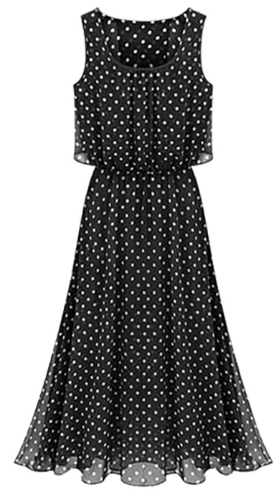
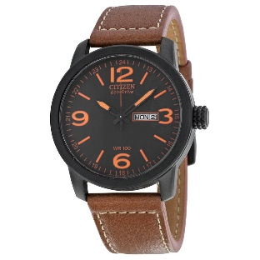
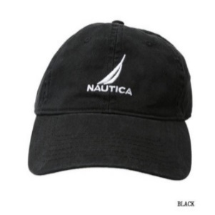
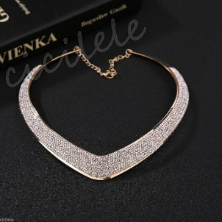
Scenario
Does it match me?

Slide 4
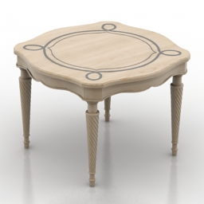
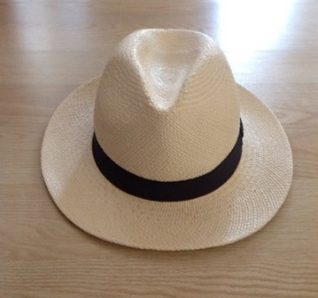
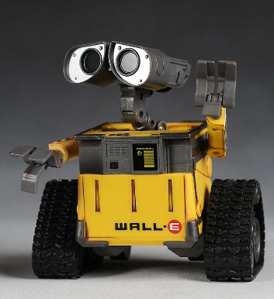
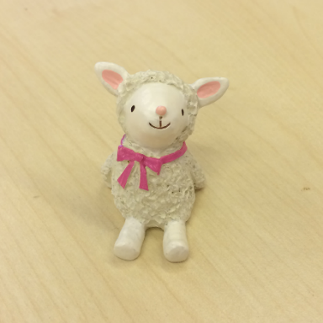
Scenario
How big is it ?

Slide 5
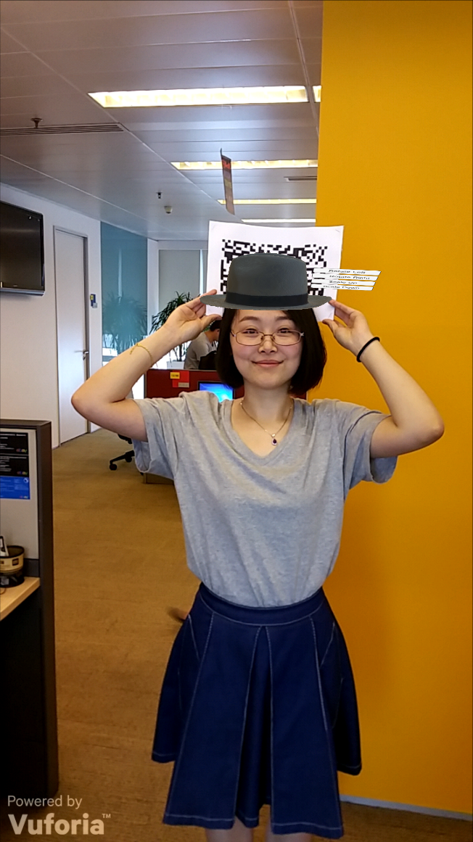
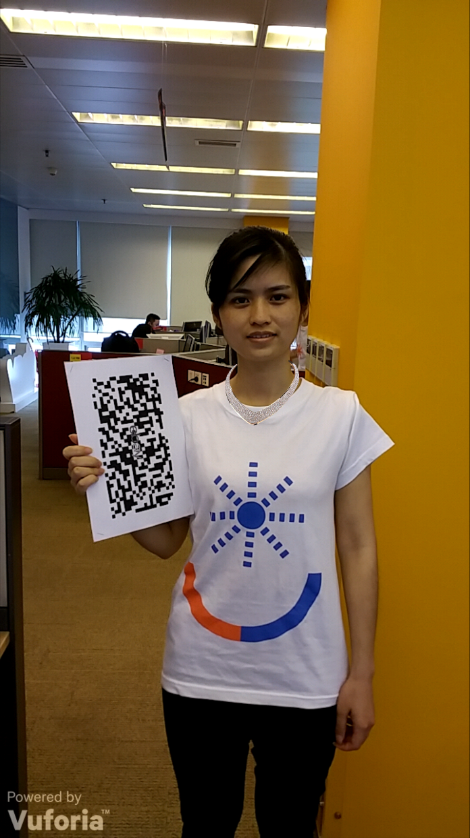
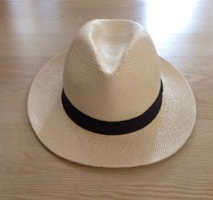

Solutions
Bring the virtual product of real size to you
The style matches or not ?

Slide 6
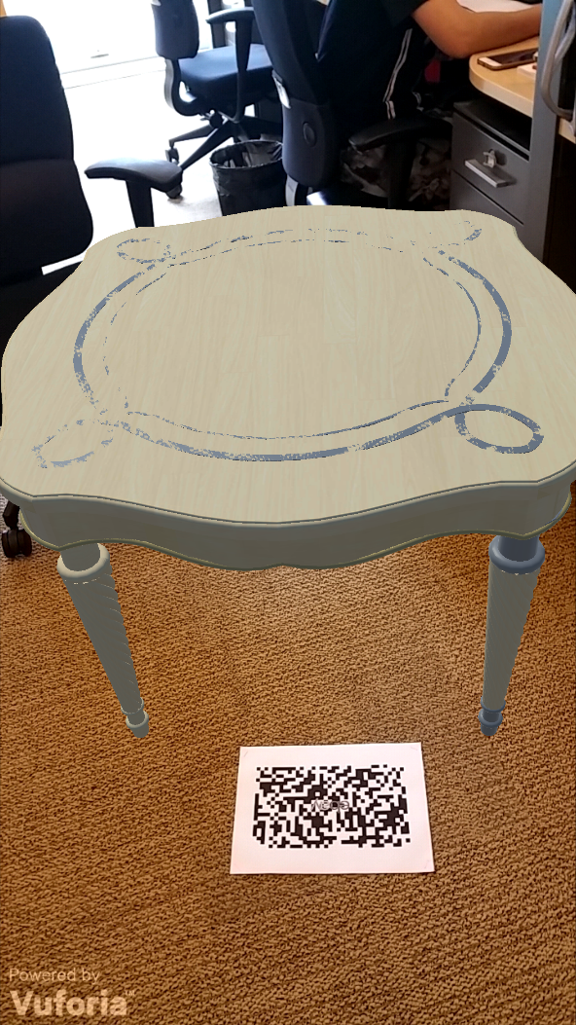
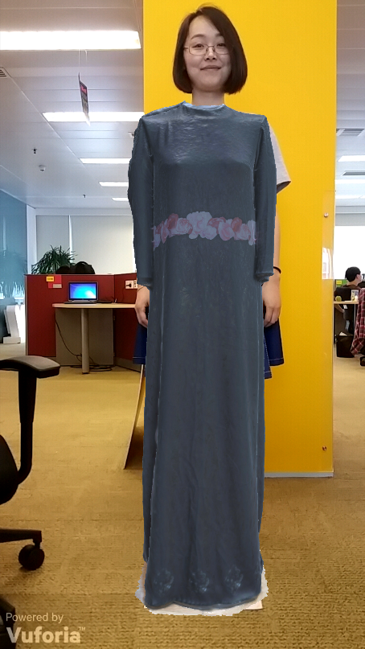
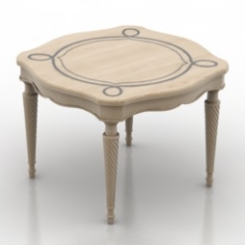
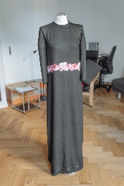
Solutions
Bring the virtual product of real size to you
The size matches or not ?

Slide 7

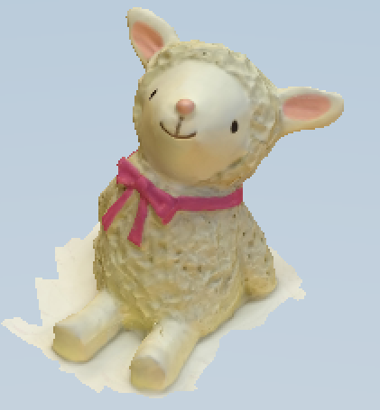

Modeling
3D Model
Real products
3D Model
123D Catch
Auto Modeling
123D Catch
take photos -> 3D Model
Manual Modeling
3ds max

Slide 8
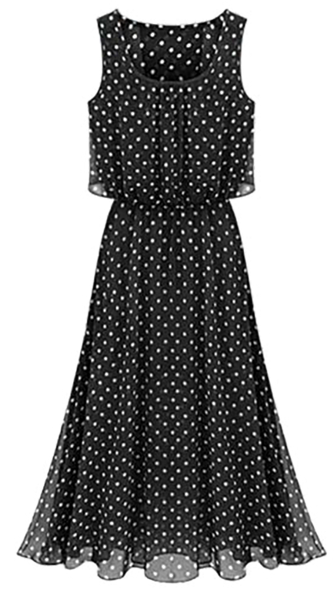

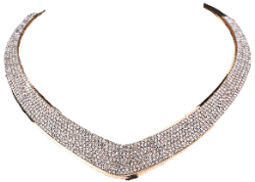
Modeling
2D Model
Take a picture
Dress
Necklace
Hat

Slide 9
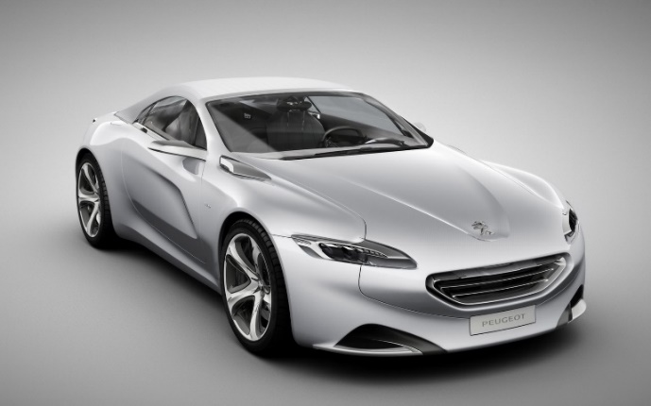
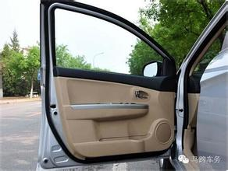
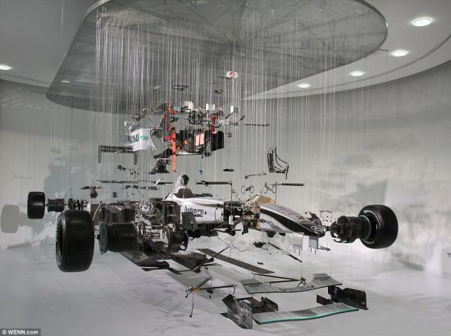
Future
More details and interaction
See every little components

Slide 10
Strengths
Vivid products experience
Match or not? By Style and Size
Interaction with products
Auto Modeling
Take pictures only ( 3D or 2D )

Slide 11
Thank you
eBay AR
Peng Ivan, Wang, Jing, Zou Daohua, Yang Baoling
2016.6.24

